Slide 1
DOM

Slide 2
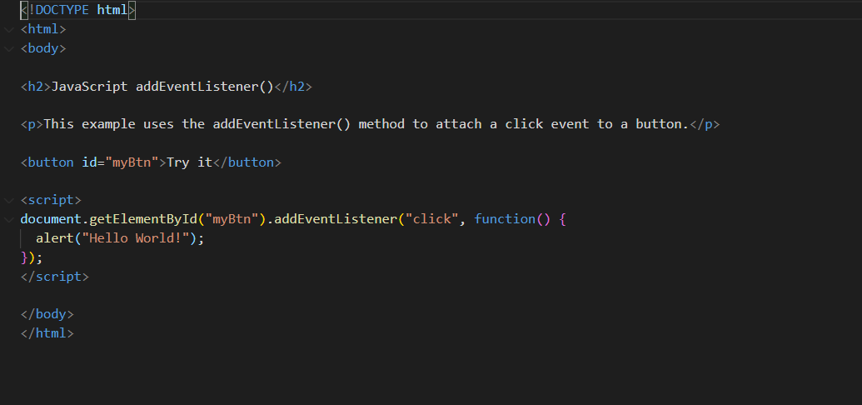
Event Listener

Slide 3
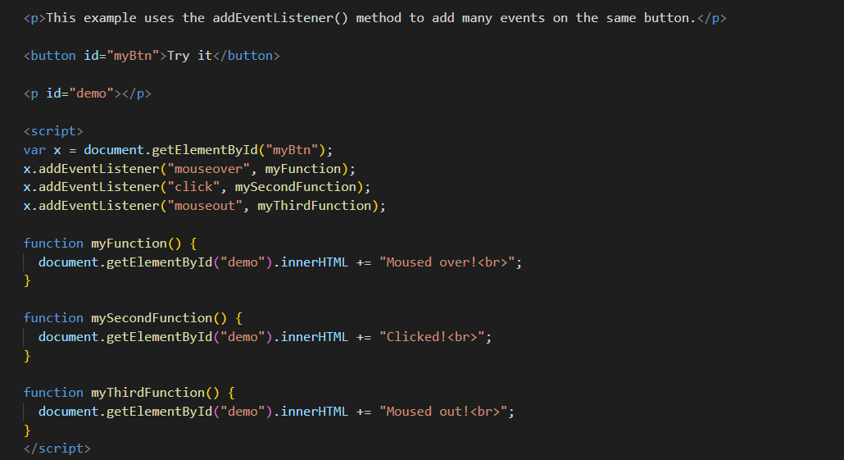
Event Listener

Slide 4
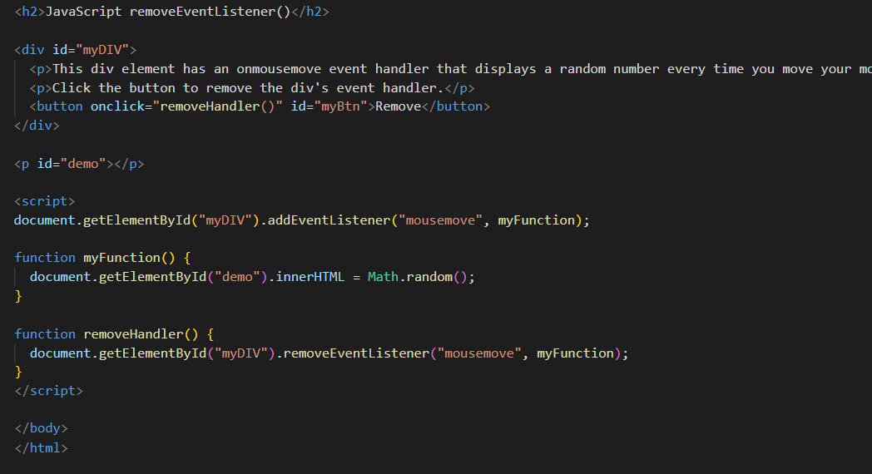
Remove Event Listener

Slide 5
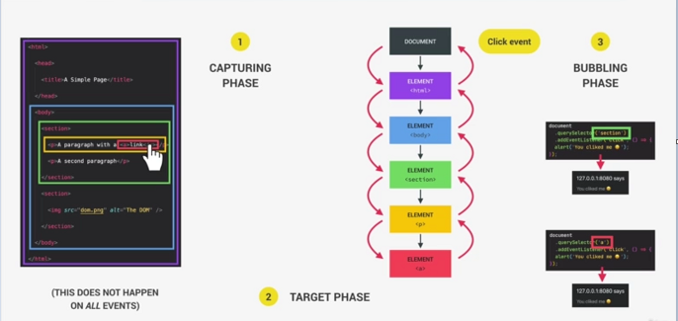
Bubbling and Capturing

Slide 6
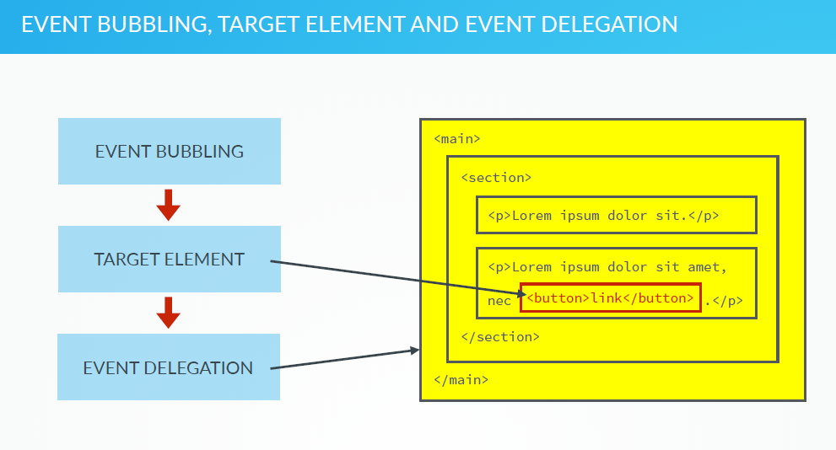

Slide 7
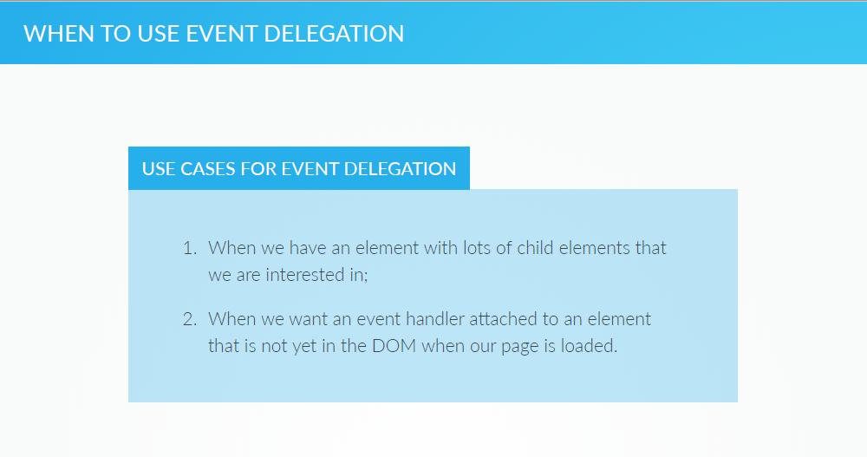

Slide 8
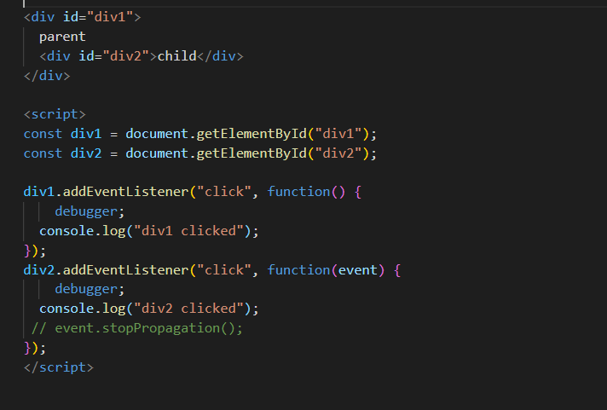
Event Bubbling Example

Slide 9

Difference between preventDefault() and stopPropagation()

